Slide 1

Project Chatbot
Victoria Hektor​
Notes:
Welcome to my presentation on Project Chatbot

Slide 2
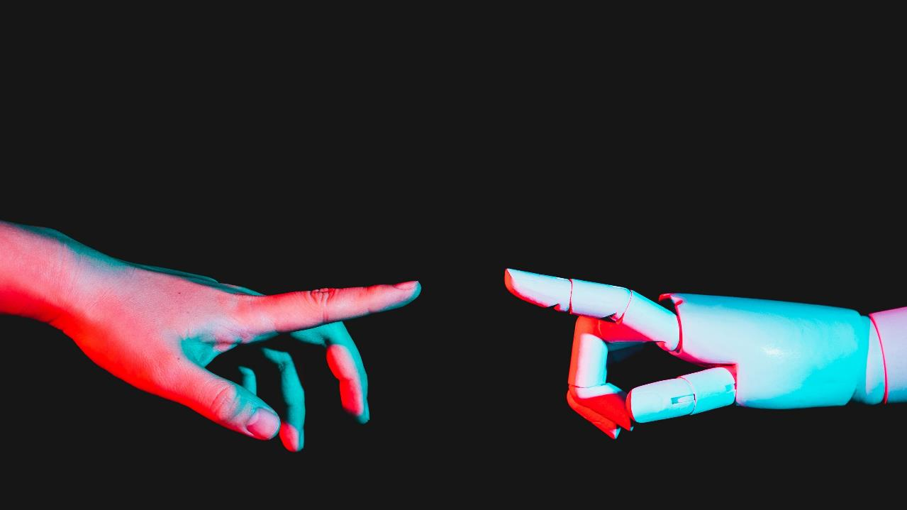
Introduction
Notes:
I will go through from start to finish, the tasks I have attempted to implement, the problems I faced, and my success

Slide 3



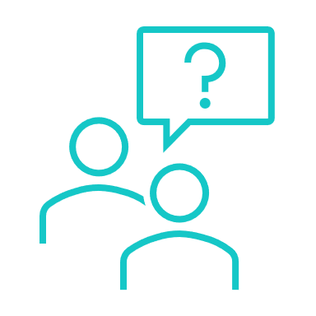
Changes Implemented
GCN
Different Encoder-Decoder Architectures
Data
Hyperparameters
Implemented GCN.
Attempted to run it through the encoder.
Printed Tree from GCN Graph.
This I struggled with and wasn’t successful.
Reverted to previous code to fix.
Discovered Transform Architecture, but not enough knowledge to successfully implement.
Researched various datasets, Ubuntu seemed to fit for my task.
Issue with converting from Py2 to Py3.
Issue with filepaths in the code within the dataset.
Successfully changed and played around with all hyperparameters.
Best Convergence when itrs were 20k+
Added in a graph to depict convergence over time
Notes:
Modify the GCN Layer Structure:
Description: Tried to alter the architecture of the GCN part of model. This included changing the number of GCN layers, the number of hidden units in each layer, and attempting to introduce new types of layers like Graph Attention Layers (GAT). With this I kept getting errors so reverted back to previous code.
Consideration: Ensure that the output dimensions of the GCN match the expected input dimensions of the subsequent parts of your chatbot model.
Introduce Attention Mechanisms:
Description: Implement attention mechanisms in your chatbot, especially in the decoder part. Attention mechanisms can help the model to focus on specific parts of the input sequence, which is particularly useful in seq2seq models.
Impact: Adding attention can potentially improve the chatbot’s ability to generate more coherent and contextually relevant responses, especially in longer conversations or more complex queries.
Consideration: Attention mechanisms can increase the computational complexity of the model. It's important for me to evaluate the trade-off between performance improvement and increased computational demand.
Experiment with Different Encoder-Decoder Architectures:
Description: Explored different architectures for the encoder and decoder of my chatbot. Tried to replace the recurrent neural network (RNN)-based architecture with a Transformer-based model, which has shown significant success in various NLP tasks, again, this was fraught with errors.
Impact: Different architectures can greatly affect how the model processes and generates language. For example, Transformers provide parallel processing and can handle longer dependencies in the text compared to RNNs.
Consideration: Changing the core architecture of the encoder-decoder model can require substantial modifications in data preprocessing, training procedures, and hyperparameter tuning, and this is where I struggled.

Slide 4
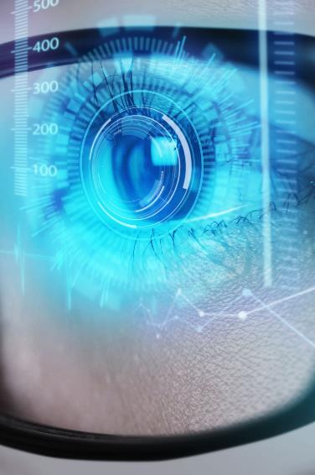
Problems
Coding Errors
Limited Tutorials
Implementation
Understanding the Methodology
Computational Equipment Lacking
Poor Chatbot Responses
Google Colab Limits
Notes:
GCN - integrating a GCN into a chatbot is a complex task that requires careful consideration of the nature of the data and the specific requirements of the application.
I feel that time and resources negatively impacted my ability to deliver working code and to grasp a good understanding of the topics.
Google Colab Kicked me off multiple times, could not use high iterations as it kept stopping the process and putting error out at 90% complete wasting 2 and half hours every time. The one success of 50k itrs had the best chatbot responses and convergence.

Slide 5
Solutions
Further Learning
Debugging
Stackoverflow
Revert to Previous Version
Understanding errors
Data Analysis
Notes:
To counteract my issues, I attempted to delve deeper and carry out further learning in these subject areas (GCN mostly, Bahdanau Attention (known as additive attn or Concat attn), different datasets (Ubuntu).
Debugging with a lot of print statements and searching high and low on Stackoverflow.
Ensuring I kept some sort of version control to enable me to revert back.
To ensure a better data analysis happened with new datasets, I spent several hours researching the Ubuntu and other datasets and still don’t fully understand it yet, so I know that it needs more time spending on it.
I also tried my best to understand the errors so I could effectively fix any errors in my code, although I couldn’t fix them all, it still helped me learn and progress in terms of upping my coding game.

Slide 6

Summary
While developing my chatbot, the initial phase focused on fine-tuning various parameters, such as the teacher forcing ratio, learning rate, and the number of layers, which are pivotal in shaping the model's learning dynamics. This phase was followed by the integration of visual tools for evaluation, providing insightful perspectives on the model's performance. Efforts to enhance the model's complexity were undertaken through experiments with Graph Convolutional Networks (GCNs) in the encoder, although these were met with challenges. Subsequently, exploration into alternative attention mechanisms and datasets was initiated but constrained by time. Despite encountering numerous challenges throughout this journey, the process was rich in learning experiences, contributing significantly to a deeper understanding of the intricate aspects of chatbot development.

Slide 7
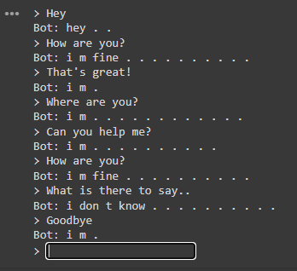
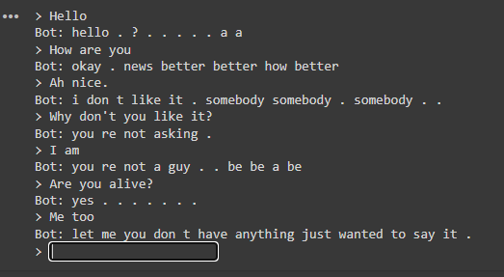
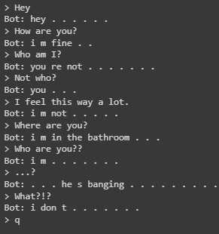
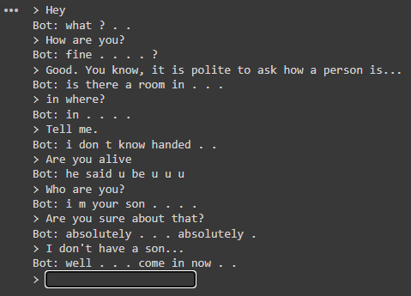
Thank you

